Slide 1
Chapter 17
Health Psychology
© 2020 McGraw-Hill Education. All rights reserved. Authorized only for instructor use in the classroom. No reproduction or further distribution permitted without the prior written consent of McGraw-Hill Education
Notes:
Photo credit: © Jamie Grill/JGI/Getty Images

Slide 2
But first… Announcements!
Research pool closes 11/28 @ 5:00pm
Quiz 11 due 11/29 @ Midnight
Don’t show up on Thursday! (11/24)
Exam 4 (12/1)
Final (12/6 @ 1:00pm) FINAL IS OPTIONAL

Slide 3
What is Health Psychology?
Practice of helping motivate people towards making health-conscious decisions
Interested in how the mind and body are linked
Key questions:
  What motivates people to make healthy decisions?
  Why do some people make healthy lifestyle choices when others don’t?

Slide 4
What do Health Psychologists do?
In addition to researching health motivation:
  Design and create treatment plans using psychological principles:
    Example: Using therapy methods to change eating habits, get individuals to stop smoking, etc.

Slide 5
Health Psychologist Example
Often look at link between body and mind
Is there a link between physical and mental symptoms?
Example: Individual reports headaches and stomach problems due to anxiety
  Is the anxiety causing the physical symptoms or is the other way around?

Slide 6
Research in Health Psych
Much research is applied in nature
Applied research looks for solutions to practical problems
  Example: Researching the link between nicotine and stress as part of a smoking intervention

Slide 7
Health Psych is different from:
Behavioral Medicine
  focuses on social, behavioral and biomedical factors
Health Promotion
  helps individuals improve their lifestyles
Public Health
  helps policy makers

Slide 8

Biopsychosocial Model
Health psychology integrates biological, psychological, and social factors in health.

Slide 9
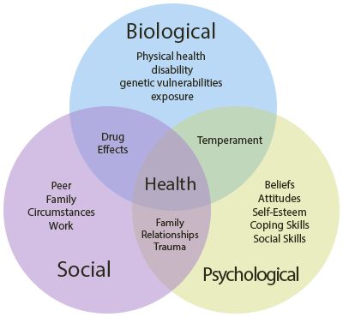

Slide 10
The Mind-body Relationship
The impact of the mind on the body
            choices & attitudes
        Example: Diabetes and Anxiety
          Diabetes requires carefully monitoring of blood sugar
          Anxiety might cause individuals to miss these cues, leading to complications
          Missing cues → more anxiety → cycle repeats

Slide 11
The Mind-body Relationship
The impact of the body on the mind
            physical stress & health
        Example: Stress and Immune System
          Stress diminishes white blood cell response, leading to prolonged illness
          Being sick longer → more stress → cycle repeats

Slide 12
The Role of Health Psychologists
        Focus on mind-body relationship!
        Helping individuals w/ mental elements will improve physical outcomes
        Often work in partnership with a physician who treats physical health issues

Slide 13
The Role of Health Psychologists
        Because health outcomes are linked to behavior, health psychologists often focus on changing how a person acts
        Rewarding individuals for engaging in healthy practices
        Operant conditioning!

Slide 14
Theoretical Models of Behavioral Change
Theory of Reasoned Action
  Effective change requires:
    specific intentions about behavior
    positive attitude about the new behavior
    perceptions of social group support
  Changing behavior requires effortful commitment!

Slide 15
Theoretical Models of Behavioral Change
Theory of Planned Behavior
  Effective change also requires:
    perceptions of control over the outcome
    High vs. Low perceived control
Criticism: Sometimes our health decisions are not rational.

Slide 16
How Do Individuals Make Healthy
Lifestyle Changes?
Stages of Change Model
  1. Precontemplation
    not ready to even think about it
  2. Contemplation
    acknowledge problem
  3. Preparation/determination
    plan action, explore options
  4. Action/willpower
    commit to and enact plan
  5. Maintenance
    long term success avoiding relapse; Achieve Transcendence

Slide 17
How Do Individuals Make Healthy
Lifestyle Changes?
Transcendence: Individual no longer consciously tries to maintain healthy lifestyle
Healthy behavior is now a habit!
Examples: An individual is now a committed runner; a smoke is now a non-smoker, etc.

Slide 18
How Do Individuals Make Healthy
Lifestyle Changes?
Relapse: Return to previous unhealthy patterns
Relapse is common: Most people who attempt to change usually fail at first
One slip-up is not usually a problem, becomes a problem when failure becomes the norm

Slide 19
Personal Motivation
What motivates people to act in certain ways?
What leads people to make healthy vs. unhealthy decision?

Slide 20
Personal Motivation
Self-Determination Theory:
  How do people make choices and manage their own lives?
  Self-determination is related to degree of control
    High-control individuals == feel in control of their own life, feel like they can make changes when needed
    Low-control individuals == feel like their life is controlled by other people, “just along for the ride”

Slide 21
Personal Motivation
Intrinsic vs. Extrinsic Motivation
People who are intrinsically motivated:
  Engage in activates for the inherent reward
People who are extrinsically motivated:
  Motivated by outside factors

Slide 22
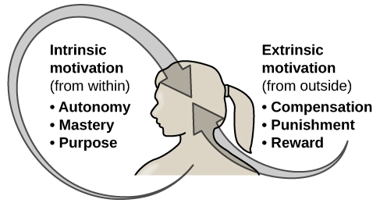
Personal Motivation

Slide 23
Which one is better?
Extrinsic motivation:
  Good for short-term goals or changes
Intrinsic motivation:
  Better for long-term, lasting change

Slide 24
Self-Efficacy and Health
Self-Efficacy:
  Belief that one can master a situation or achieve something
  Higher levels == greater health outcomes
    More likely to stick to plans
    Less likely to be discouraged by setbacks
    More likely to find solutions to problems

Slide 25
Coping with Stress
How we respond to environmental difficulties is important for health outcomes
Stress == Body’s response to circumstances that threaten it
General Adaptation Syndrome == common effects of stress on the body (occurs in three stages)

Slide 26
General Adaptation Syndrome: Stage 1
Alarm: Temporary state of shock; body mobilizes resources
  Stress hormones are released
  These hormones temporarily reduce immune system functionality
  Most prone to infection/injury during this stage

Slide 27
General Adaptation Syndrome: Stage 2
Resistance: Body is now ready to face the threat
  Nervous system activity decreases, body adapts to the stress
  Hormones that protect the body are released
  Immune system becomes more effective (higher than when non-stressed); Less prone to infection!

Slide 28
General Adaptation Syndrome: Stage 3
Exhaustion: Keeping up the resistance stage for too long takes a toll on the body
  Physical exhaustion, increased vulnerability to disease, or even death in extreme cases

Slide 29
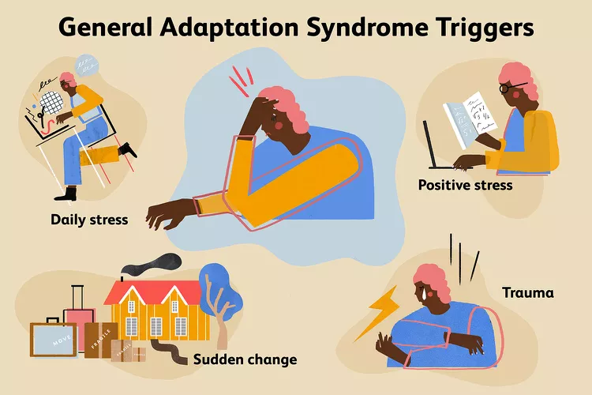

Slide 30
Types of Stress
Acute Stress
  Sudden, one-time life events (trauma, sudden death, etc.)
  Associated with poor immune system function
Notes:
Suggestion: Tie this back to Selye’s G.A.S. model.

Slide 31
Types of Stress
Chronic Stress
  Long-term worry/stress (relationship problems, financial worries, etc.)
  Also related to immune system problems, but problems are more long-term than acute stress
Notes:
Suggestion: Tie this back to Selye’s G.A.S. model.

Slide 32
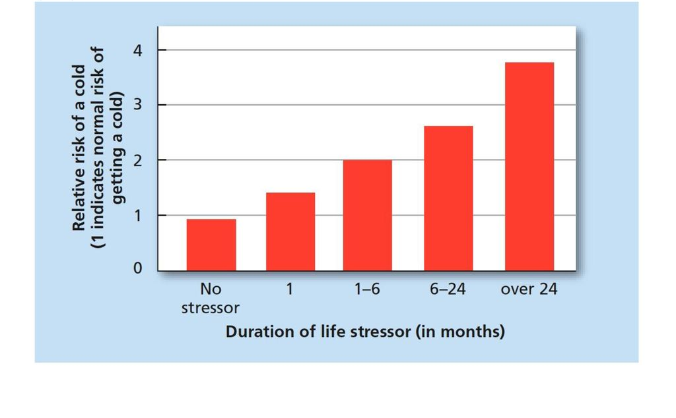
Impact of Stress
Notes:
Suggestion: Tie this back to Selye’s G.A.S. model.

Slide 33
Impact of Stress
Cardiovasular Disease
  chronic emotional stress
  major life changes increase risk
Cancer
  stress inhibits cellular immune responses

Slide 34
Social Support and Stress
Social Support: Information and feedback from others
  Important, because it indicates than an individual is loved, esteemed, valued, etc.
  Three types of benefits

Slide 35
Benefits of Social Support
Tangible Assistance:
  Family/friends can provide goods and services during stressful times
Information:
  Supporting individuals can provide suggestions to help cope w/ trauma or stress
Emotional Support:
  Individuals under stress usually suffer emotionally. Social support can diminish these problems

Slide 36
Stress and Personality
Are some people more prone to experiencing stress than others?
Probably not… Better is question is do some people cope better than others?

Slide 37
Personality Types and Stress
Type A individuals:
  Excessively competitive, hard-driven, hostile
Type B individuals:
  Relaxed, easy-going, calm
Type C individuals:
  Struggle with awareness of positive/negative emotions
Type D individuals:
  Generally distressed, negative emotions, socially inhibited

Slide 38
Coping with Stress
Emotion-Focused vs Problem-Focused
Emotion-focused:
  Responding to the stress one is feeling, not the source of stress
  Example: Denial of a loved one’s death

Slide 39
Coping with Stress
Emotion-Focused vs Problem-Focused
Problem-focused:
  Facing the source of one’s problem and attempting to solve it
  Example: Seeking out tutoring if you’re having a problem in class

Slide 40
Coping with Stress
Optimism:
  Higher levels == greater coping w/ stress
  Related to how people explain bad events
    Optimists: more likely to bad events as external, unstable, and specific to certain situations
    Pessimists: internal, stable, and global

Slide 41
Coping with Stress
Hardiness
  Sense of commitment and of control
  Perceives problems as challenges, not threats
High control individuals face challenges head-on; feel they can solve problems

Slide 42
Coping with Stress
Stress Management Programs
  Teach individuals how to appraise stressful events, developing coping skills, and use them when needed
  Many different types
    Relaxation techniques
    Assertiveness training
    Anger management programs

Slide 43
Done! Reminders!
Exam 4 (Thursday 12/2) (NOT OPTIONAL)
Final Exam (12/6) (1:00pm – 3:00pm) (OPTIONAL)

